Slide 1
CSCE 623 In Class Day 03
Synchronous session

Slide 2
Agenda for Day 03
Activity 1: Warmup Coding Practice: making structures in numpy, basic operations
Activity 2: Simple linear regression with hand-selected model parameters
Intro to HW1
Questions & Dismissal

Slide 3
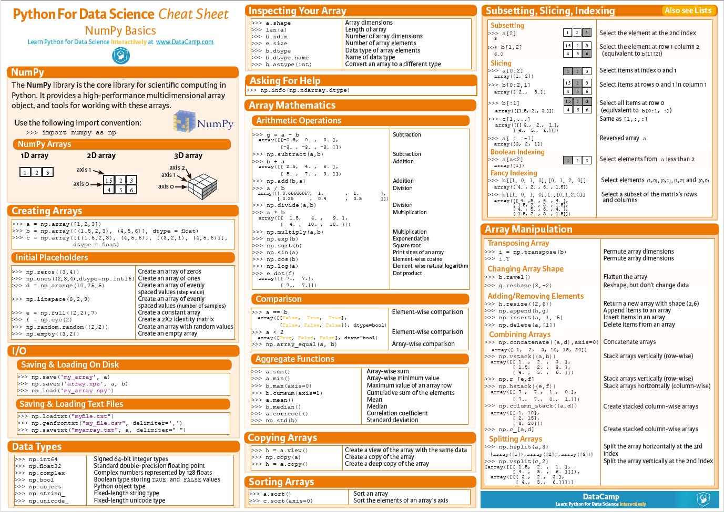
Activity 1: Warmup (instructor-guided coding; 25 min)
Creating scalars, vectors and matrices using numpy.array()
Checking Array Dimensions
Checking variables for equality
Matrix operations
element-wise multiplication
matrix multiplication
Vectorizing computations for RSS, MSE and RMSE

Slide 4
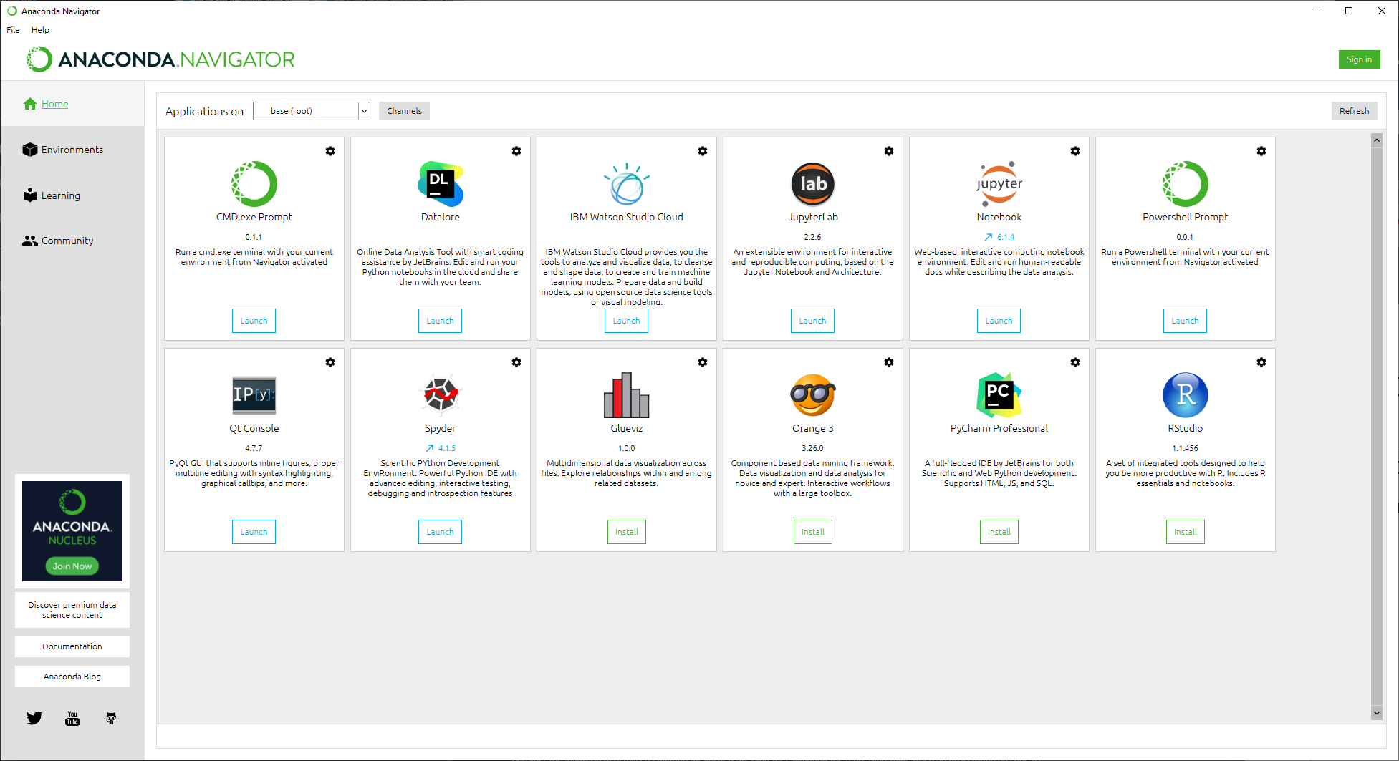
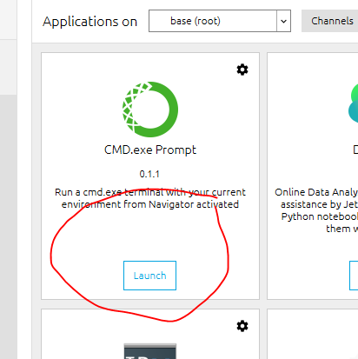
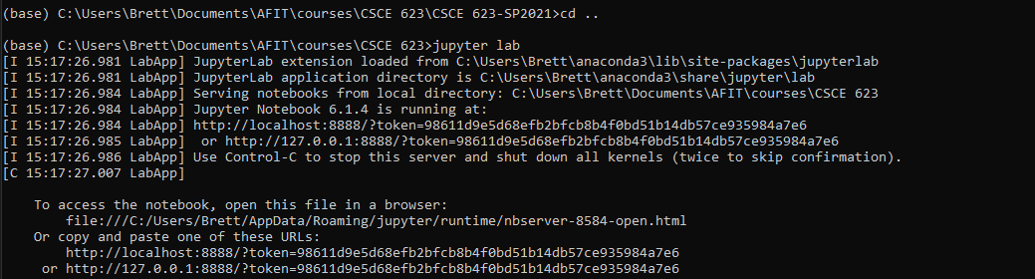
Local Start
…or… Colab Start https://colab.research.google.com/
Start Anaconda
Select CMD.exe & Launch
Go to your local directory
Start
“Jupyter Notebook” or
“Jupyter Lab”
Windows Suggestion: Pin the CMD to task bar so you don’t have to start anaconda each time.

Slide 6
Activity 2: Simple linear regression (coding; 25 min)
Overview
Data Preprocessing: Storing data as a matrix & converting to a “design matrix”
Model Fitting: Hand-Picking coefficients to make a parametric model
Prediction: Using the model to make predictions on new data
Evaluation: Comparing predicted and actual values and computing error
Goal: By hand, conduct some of the activities of machine learning that will be conducted algorithmically in the future

Slide 7

Activity 2 overview: coding exercise (1/4)
This exercise will explore 1-dimensional linear regression (one feature is used to predict the target variable)
You will manually fit the 2-parameter model to the data by guessing and testing different beta coefficients until you get a low error
Directions:
Obtain the python starter code from canvas
Start Anaconda Or Colab; open Jupyter Notebook (or Jupyter Lab)
Follow instructor directions in each part of the notebook
After completing, compare your work with the solution
$$f(X_{i})=β_{0}+β_{1}X_{i1}$$

Slide 8
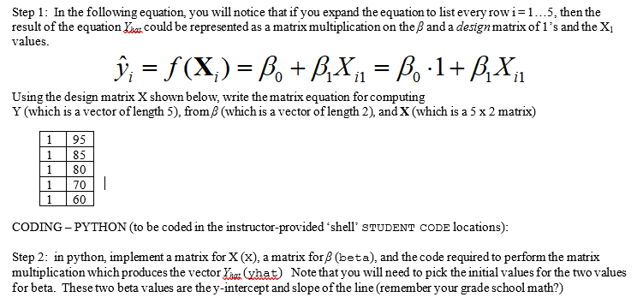
Activity 2 overview : coding exercise (2/4)

Slide 9
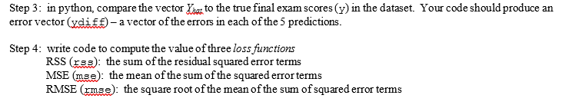
Activity 2 overview : coding exercise (3/4)

Slide 10
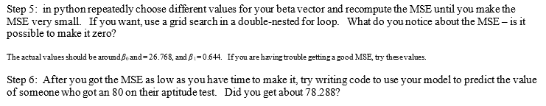
Activity 2 overview : coding exercise (4/4)

Slide 11
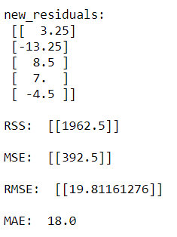
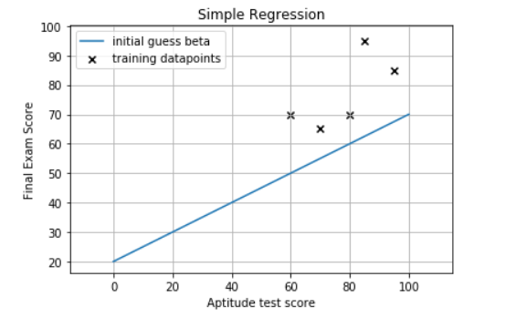
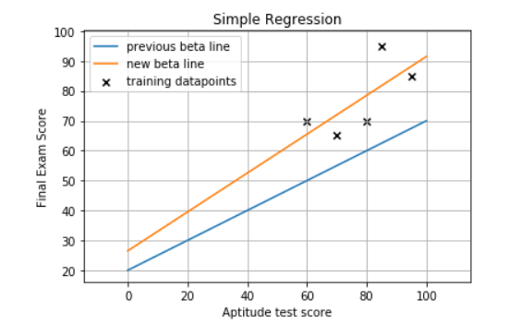
Simple Linear Regression Learning Activity Review (things to think about for discussion)
Math Stuff
How did we use linear algebra to produce ALL the predictions on all observations simultaneously?
How did we summarize the errors efficiently
Visualization and Decision-making
How did you use the plots to help you refine your guesses for B0 & B1 visually
How could an algorithm use the error terms to incrementally improve the selection of B0 & B1?

Slide 12
Mini-Lecture: Parameter finding - closed form solutions vs. iterated optimization

Slide 13
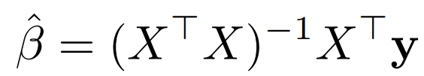
Rationale for ML iterated model fitting (1/2)
In linear regression, the OLS “closed form” solution works well if the dataset is small enough and the matrix can be inverted
Computation time:
Assume X is a matrix of shape (N , (M+1)) where N is the number of operations and M is the number of features (columns of data)
How big of a matrix is X^{T}X?
What is the computational complexity of taking the inverse of a matrix?
What is the big-OH of a matrix inversion?

Slide 14
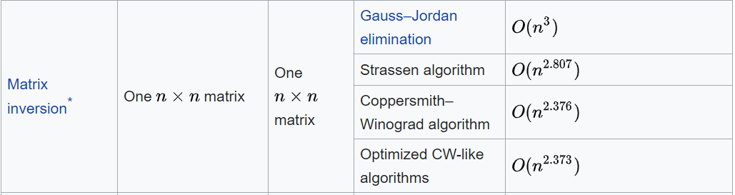
Rationale for ML iterated model fitting (2/2)
In linear regression, the OLS “closed form” solution works well if the dataset is small enough and the matrix can be inverted
XTX is an NxN matrix…
The order of the operation to compute the inverse is worse than quadratic
If the number N is too large, matrix inversion is not feasible
In other ML models there is no “closed form” solution
Another method is needed
(… to be continued…)
Sources: http://pages.cs.wisc.edu/~jerryzhu/cs731/regression.pdf https://en.wikipedia.org/wiki/Computational_complexity_of_mathematical_operations

Slide 15
Questions?

